Slide 1
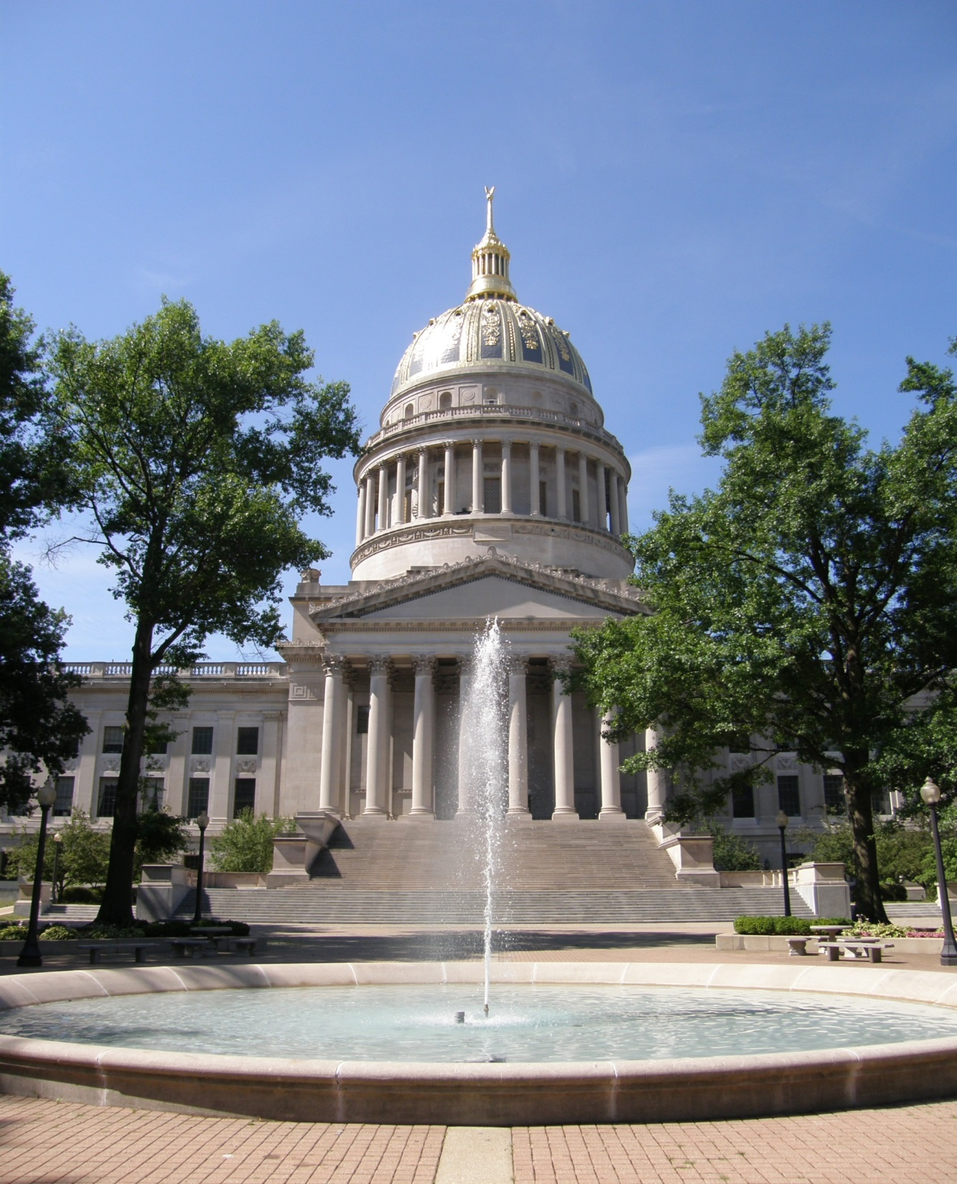
Department of Administration
House
Budget Meeting
Fiscal Year 2023 Budget
(January 2022 session)
Mark D. Scott
Cabinet Secretary

Slide 2
Department of Administration Agencies
Office of the Secretary
Aviation
Board of Risk and Insurance Management
Consolidated Public Retirement Board
Ethics Commission
Equal Employment Opportunity Office
Finance Division
Fleet Management
General Services Division
Grievance Board
Office of Technology
Personnel Division
Prosecuting Attorney’s Institute
Public Defender Services
Public Employees Insurance (and Retiree Health Benefits Trust Fund)
Purchasing Division
Real Estate Division
Surplus Property

Slide 3
Budget Challenges
Public Employees Insurance Agency
Public Defender Services
Office of Technology-Cyber Security Initiatives
General Services Division
Repairs, renovations, and preventative maintenance of the State Capitol Complex and implementation of long-range Master Plan
Maintenance and upkeep of State-owned buildings throughout the State

Slide 4
FY 2022 Supplemental Appropriation Request
General Revenue
Public Defender Services $20,000,000
Office of Technology $2,000,000

Slide 5
FY 2022 Surplus Request
General Services $4,000,000

Slide 6
No Improvements for FY 2023 are Requested

Slide 7
Revenue Sources
 | FY 2021 Actual | FY 2022 Budget | FY 2023 Request
General | 128,519,156 | 106,529,353 | 106,529,353
Special | 114,580,980 | 179,868,144 | 179,755,762
Lottery | 9,996,240 | 10,000,000 | 10,000,000
Other* | 880,902,807 | 937,264,455 | 928,396,730
 | 1,133,999,183 | 1,233,661,952 | 1,224,681,845
*Excludes retirement plans, see actual expense detail for plans on “Other (Non-appropriated) Special Revenue Agencies” slide, page 10.

Slide 8
General Revenue Agencies
Dept | Department Name | FY 2021 Actual | FY 2022 Budget | FY 2023 Request
0201 | SECRETARY OF ADMINISTRATION | 15,499,427 | 15,590,252 | 15,590,252
0209 | FINANCE DIVISION | 721,865 | 753,000 | 753,000
0211 | GENERAL SERVICES DIVISION | 36,795,758 | 27,769,219 | 27,769,219
0213 | PURCHASING DIVISION | 867,225 | 1,047,714 | 1,047,714
0215 | TRAVEL MANAGEMENT (AVIATION) | 1,082,843 | 1,260,842 | 1,260,842
0217 | COMMISSION ON UNIFORM STATE LAWS | 38,070 | 45,550 | 45,550
0219 | PUBLIC EMPLOYEES GRIEVANCE BOARD | 1,144,379 | 1,124,712 | 1,124,712
0220 | ETHICS COMMISSION | 643,518 | 719,844 | 719,844
0221 | PUBLIC DEFENDER SERVICES | 49,619,022 | 36,135,646 | 36,135,646
0225 | PUBLIC EMPLOYEES INSURANCE AGENCY | 21,000,000 | 21,000,000 | 21,000,000
0224 | COMMODITIES AND SERVICES FROM THE HANDICAPPED | 144 | 4,055 | 4,055
0228 | PROSECUTING ATTORNEYS INSTITUTE | 280,677 | 246,653 | 246,653
0233 | REAL ESTATE DIVISION | 826,229 | 831,866 | 831,866
Grand Total |  | 128,519,156 | 106,529,353 | 106,529,353

Slide 9
Special Revenue Appropriated Agencies
Dept. | Department Name | FY 2021 Actual | FY 2022 Budget | FY 2023 Request
0201 | SECRETARY OF ADMINISTRATION | 63,562,844 | 114,747,000 | 114,747,000
0209 | FINANCE DIVISION | 982,532 | 2,000,000 | 2,000,000
0210 | INFORMATION SERVICES AND COMMUNICATIONS | 32,059,936 | 39,321,583 | 39,321,583
0213 | PURCHASING DIVISION | 1,574,693 | 2,142,050 | 2,029,668
0215 | TRAVEL MANAGEMENT - AVIATION | 426,415 | 1,027,237 | 1,027,237
0216 | FLEET MANAGEMENT | 10,287,103 | 13,205,759 | 13,205,759
0222 | DIVISION OF PERSONNEL | 4,765,436 | 6,159,914 | 6,159,914
0228 | PROSECUTING ATTORNEYS INSTITUTE | 261,401 | 554,814 | 554,814
0231 | OFFICE OF TECHNOLOGY | 660,619 | 709,787 | 709,787
Grand Total |  | 114,580,980 | 179,868,144 | 179,755,762

Slide 10
Lottery Funds
Dept. | Department Name | FY 2021 Actual | FY 2022 Budget | FY 2023 Request
0211 | GENERAL SERVICES DIVISION | $ 9,996,240 | $10,000,000 | $10,000,000

Slide 11
Other (Non-appropriated) Special Revenue Agencies
Department Name | FY 2021 Actual Expenses
TEACHERS RETIREMENT SYSTEM | 1,192,316,437
PUBLIC EMPLOYEES INSURANCE AGENCY | 713,373,191
PUBLIC EMPLOYEES RETIREMENT SYSTEM | 473,676,991
RETIREE HEALTH BENEFIT TRUST FUND | 213,539,112
BOARD OF RISK AND INSURANCE MANAGEMENT | 98,536,763
GENERAL SERVICES DIVISION | 32,477,908
TEACHERS DEFINED CONTRIBUTION PLAN | 23,719,258
CONSOLIDATED PUBLIC RETIREMENT BOARD | 8,815,865
INFORMATION SERVICES AND COMMUNICATIONS | 21,416,201
DEPUTY SHERIFF RETIREMENT SYSTEM | 13,061,511
JUDGES RETIREMENT SYSTEM | 4,265,443
SURPLUS PROPERTY | 1,857,128
FINANCE DIVISION | 3,127,473
EMERGENCY MEDICAL SERVICES RETIREMENT SYSTEM | 4,427,756
REAL ESTATE DIVISION | 487,384
PURCHASING DIVISION | 597,611
MUNICIPAL POLICE OFFICERS AND FIREFIGHTERS RETIREMENT SYSTEM | 314,103
WV PUBLIC SAFETY DEATH DIS & RETIREMENT SYS PLAN A | 44,813,410
WV STATE POLICE RETIREMENT SYSTEM PLAN B | 3,665,506
WV DIVISION OF NATURAL RESOURCES POLICE OFFICER RET SYSTEM | 7,077
PUBLIC DEFENDER SERVICES | 95,580
PROSECUTING ATTORNEYS INSTITUTE | 84,082
ETHICS COMMISSION | 33,620
GRAND TOTAL | 2,854,712,409

